Slide 1
CS2030
Tutorial 2
jeremychoo@u.nus.edu [edits by Jeremy Lim jeremylim@u.nus.edu]

Slide 2
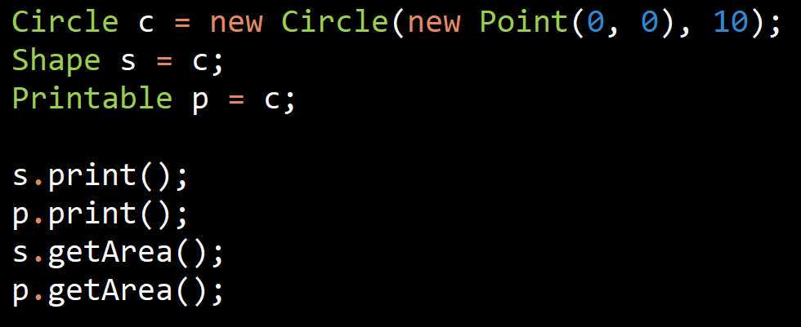
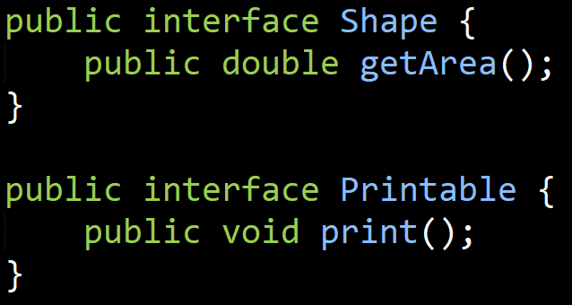
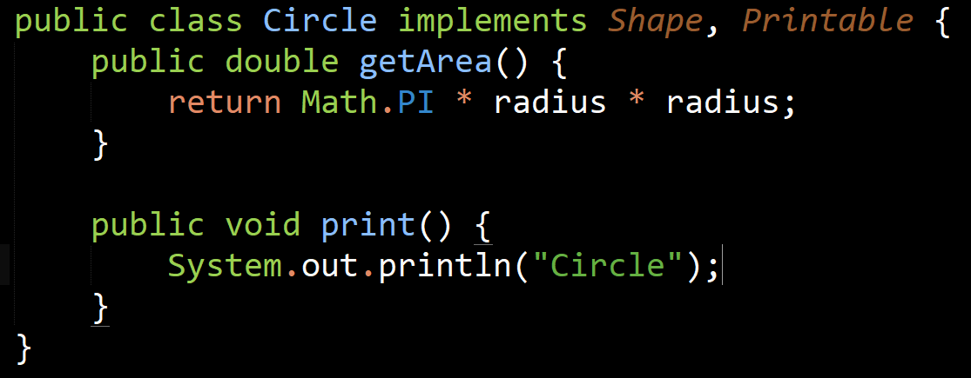
Q1: Interfaces
No
Yes
Yes
No

Slide 3
s.print() [s is a Shape]
Circle Methods
getArea
print
Circle Implementation
getArea
print
Printable Methods
print
Printable Implementation
print
Shape Methods
getArea
Shape Implementation
getArea

Slide 4
p.print() [p is a Printable]
Circle Methods
getArea
print
Circle Implementation
getArea
print
Printable Methods
print
Printable Implementation
print
Shape Methods
getArea
Shape Implementation
getArea

Slide 5
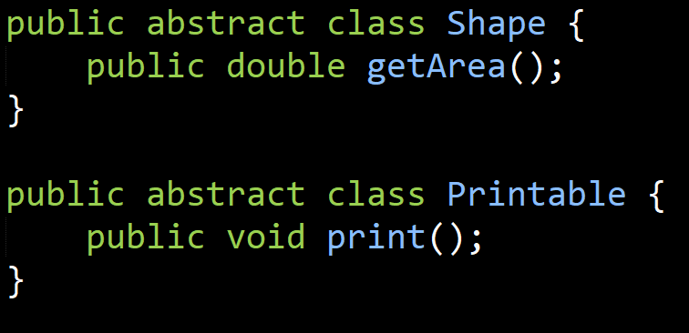
Q1: Interfaces
What if we change from interfaces to abstract class?
No.
You can only extend from 1 class.

Slide 6
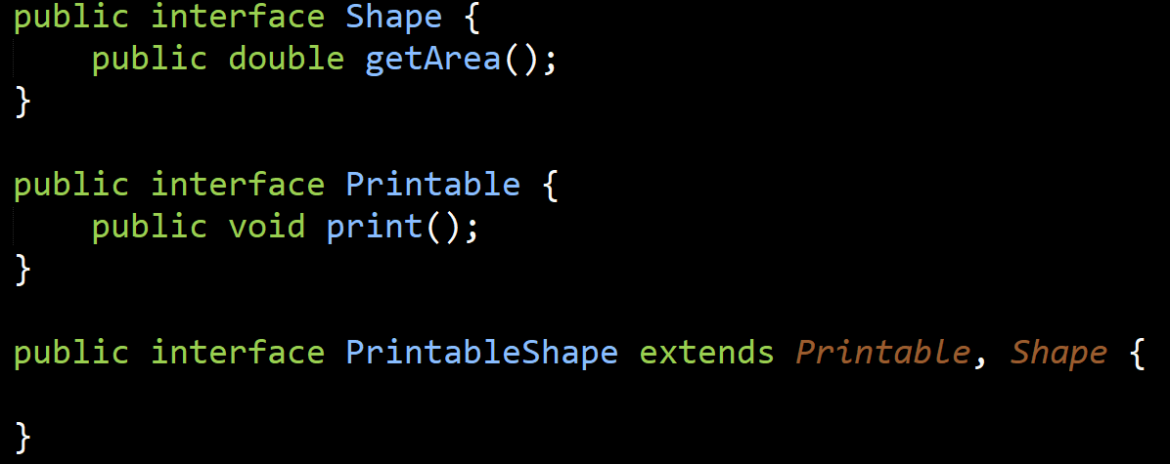
Q1: Interfaces
What if we add a new interface, PrintableShape?
Yes.
But be mindful of “interface bloat”

Slide 7
Q2: rectangle
Write a class rectangle that implements the two interfaces in Q1. You should make use of two diagonally opposite points (bottom-left and top-right) to define a rectangle. How do you handle the case where the 2 points do not define a proper rectangle?
bottomLeft [10, 5]
topRight [-5, 0]

Slide 8
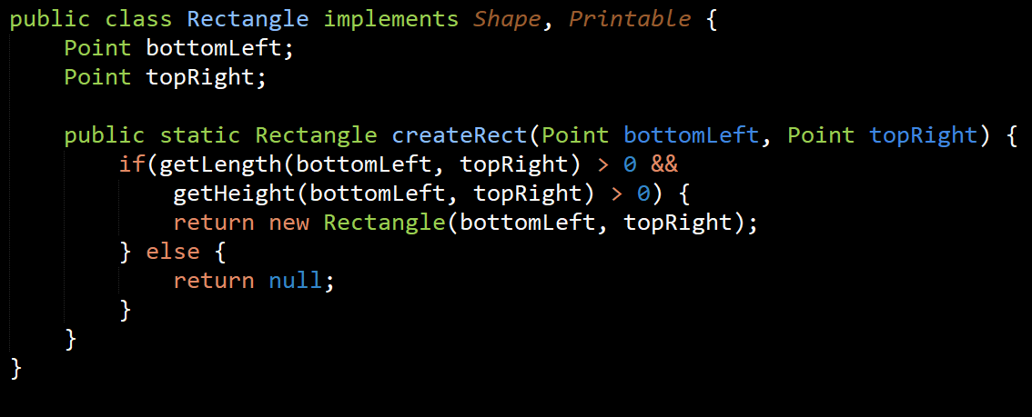
Q2: rectangle
Write a class rectangle that implements the two interfaces in Q1. You should make use of two diagonally opposite points (bottom-left and top-right) to define a rectangle. How do you handle the case where the 2 points do not define a proper rectangle?
Notes:
Where getLength(a, b) returns b.x – a.x
And getHeight(a, b) returns b.y – a.y
Reminder: What else, based on this week’s lecture? Throw an exception. Ideally, IllegalArgumentException

Slide 9
Q3: 2d to 3d
Write an interface called Shape3D that supports a method getVolume. Write a class called cuboid that implements Shape3D and has 3 private double fields: length, height and breadth.
Write a new interface Solid3D that inherits from interface Shape3D that supports 2 methods: getDensity() and getMass()
Now, write a new class called SolidCuboid with an additional private double field density. The SolidCuboid should call the constructor of Cuboid via super and provides 2 constructors: one to specify the density, and one that sets it to the default value of 1.0.
Test your implementation by writing a suitable client class.
Notes:
Mass = volume * Density
[Try it yourself]

Slide 10

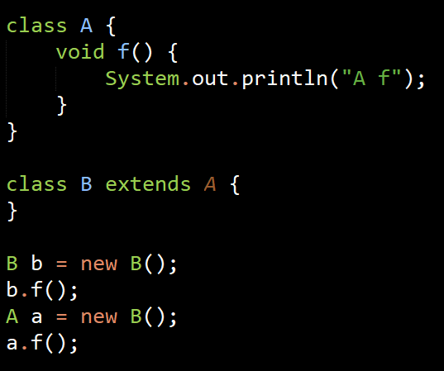

Q4a: Any errors?
A Mtds
f
A Impl
f
B Mtds
f
B Impl

Slide 11
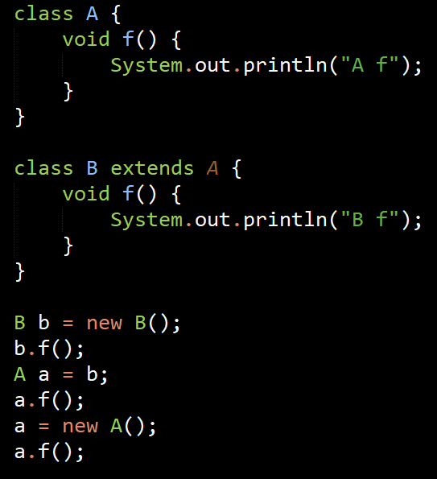
Q4b: Any errors?
A Mtds
f
A Impl
f
B Mtds
f
B Impl
f

Slide 12
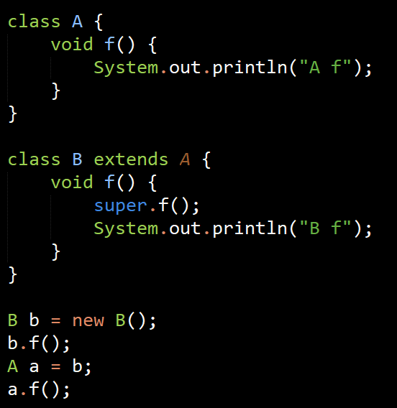
Q4c: Any errors?
A Mtds
f
A Impl
f
B Mtds
f
B Impl
f

Slide 13
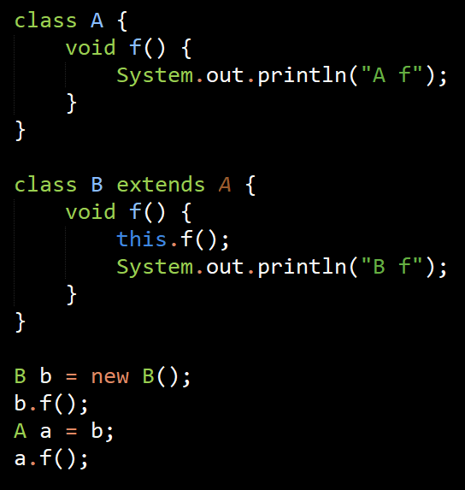
Q4d: Any errors?
Well, it compiles but calling b.f(); results in an infinite loop, causing a stackoverflow exception.

Slide 14
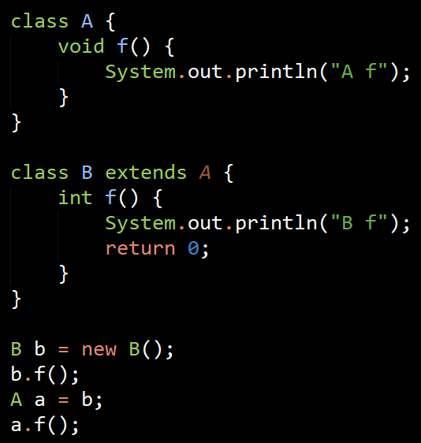
Q4e: Any errors?
Compilation error: f in B has the same method signature, which implies overriding it, but the return type is different.
A Mtds
f()
B Mtds
f()
f() :int

Slide 15
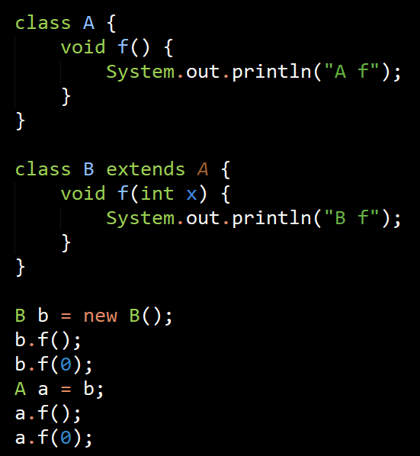
Q4f: Any errors?
a.f(0); is not ok, only a.f() is ok.
A Mtds
f
A Impl
f
B Mtds
f
f(int)
B Impl
f(int)

Slide 16
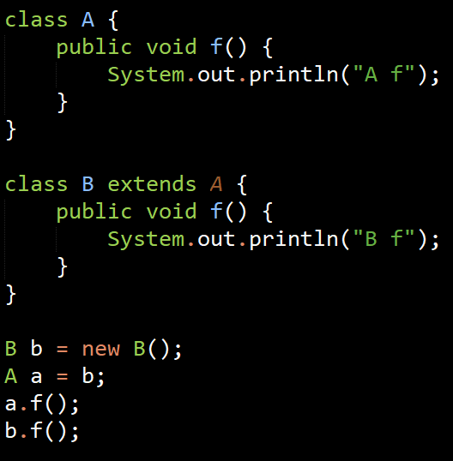
Q4g: Any errors?

Slide 17
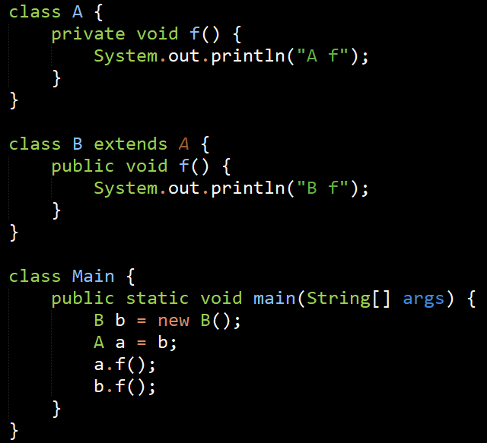
Q4h: Any errors?
a.f(); has private access.

Slide 18
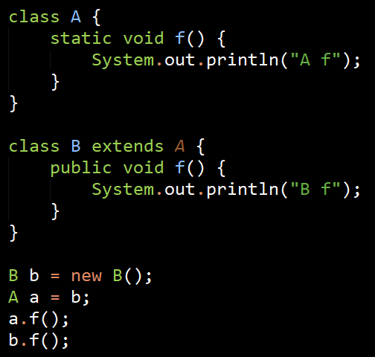
Q4i: Any errors?
Compilation error: f() in B cannot override f() in A. Static methods cannot be overwritten by non-static methods

Slide 19
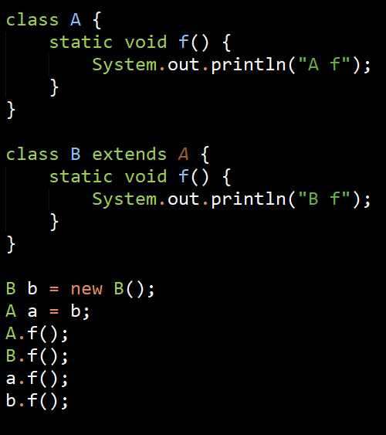
Q4j: Any errors?

Slide 20
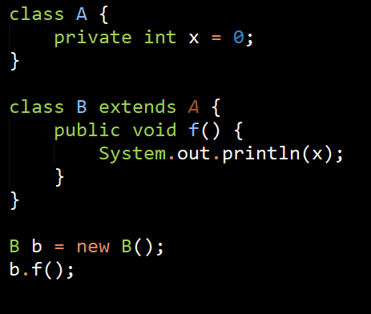
Q4k: Any errors?
Compilation error: x is private

Slide 21
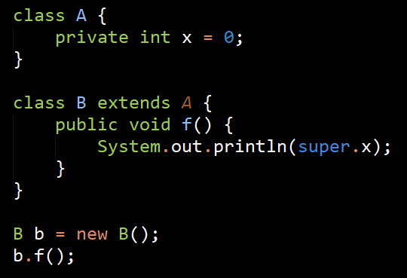
Q4L: Any errors?
Compilation error: x is private

Slide 22
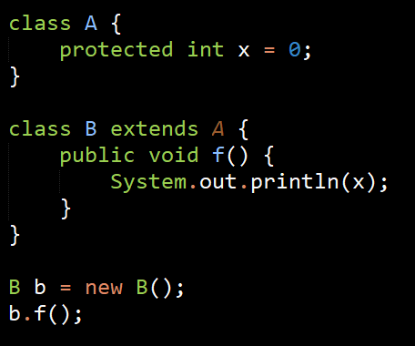
Q4m: Any errors?

Slide 23
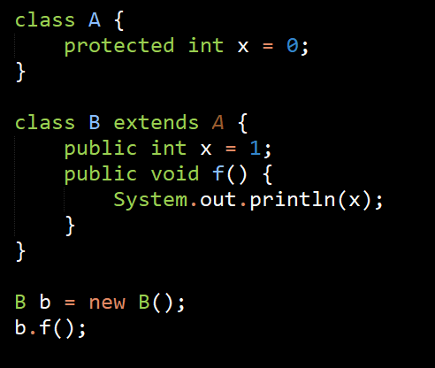
Q4n: Any errors?

Slide 24
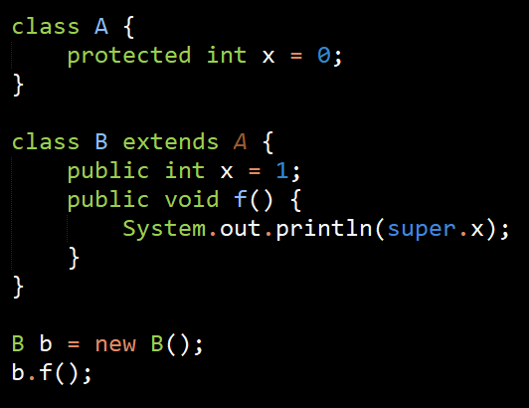
Q4o: Any errors?

